Slide 1
Algorithms for big data
Optimizing Convolution

Slide 2
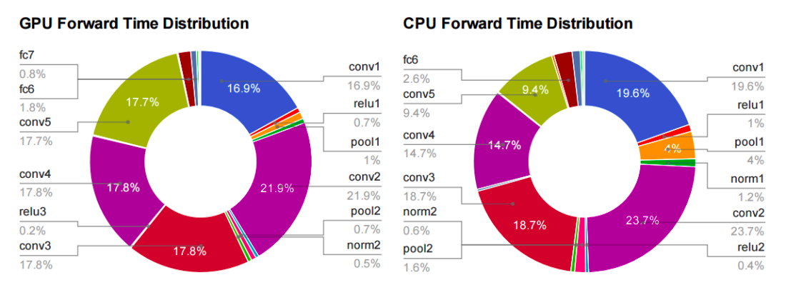
Motivation

Slide 3
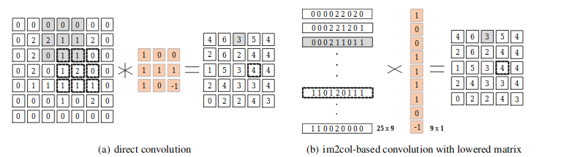
Convolution in DNN

Slide 4
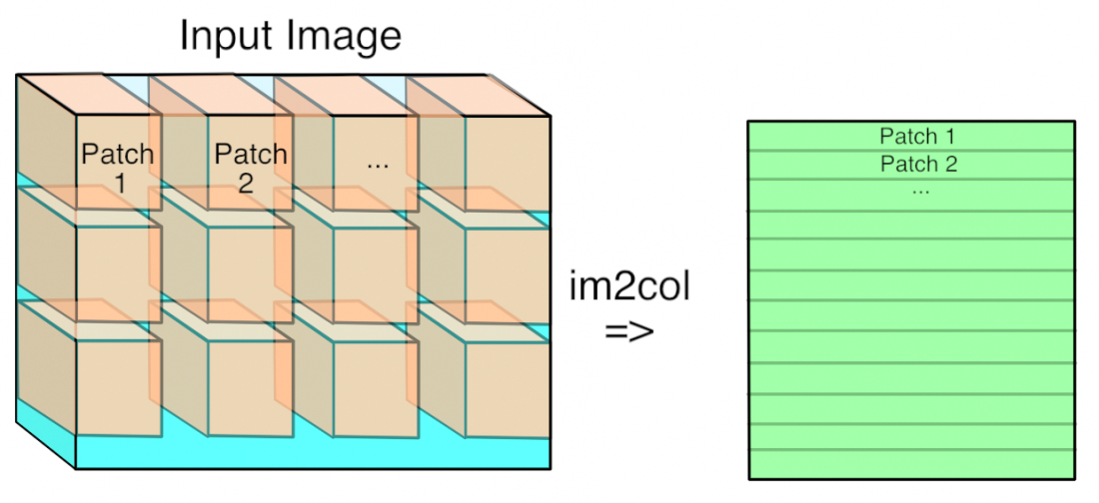
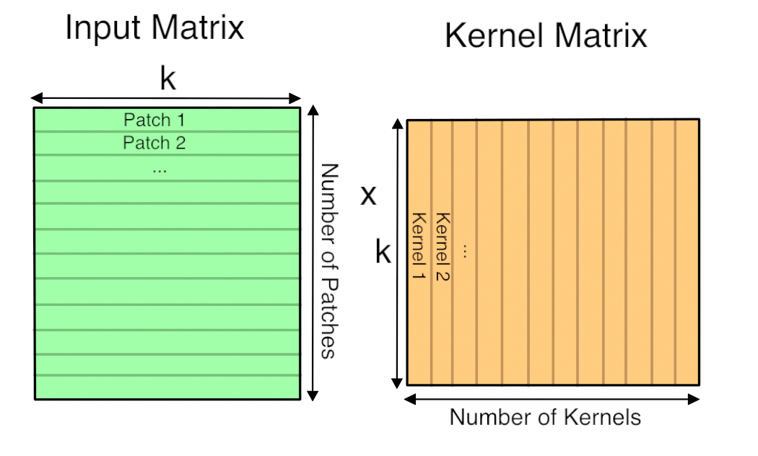
GEMM: General Matrix to Matrix Multiplication[1]

Slide 5
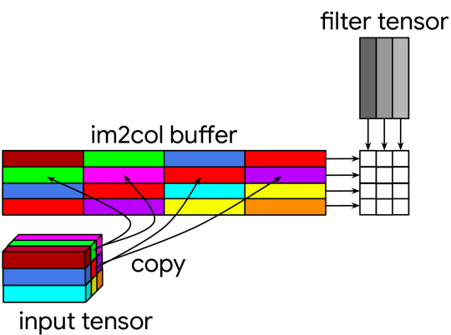
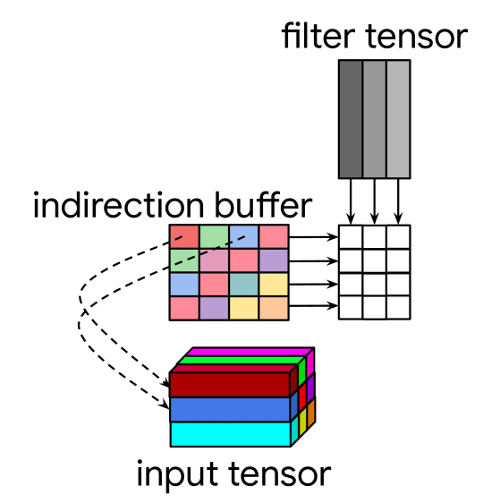
Indirect Convolution Algorithm[2]

Slide 6
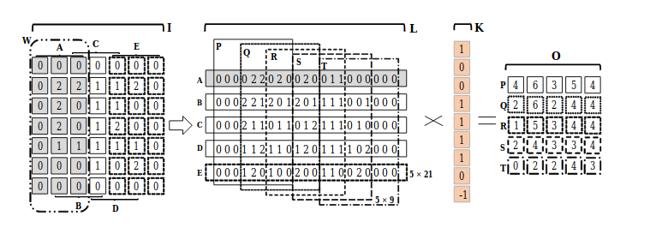
Memory Efficient Algorithm for DNN[3]

Slide 7
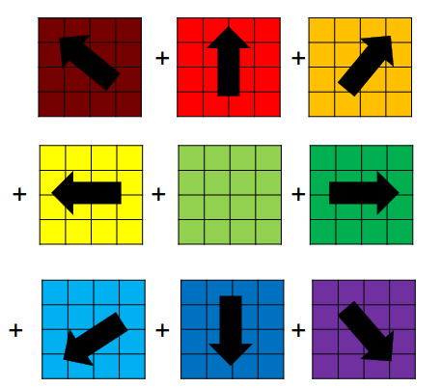
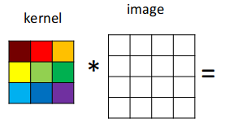
GEMM based algorithm by sum of scaled matrices[4]

Slide 8
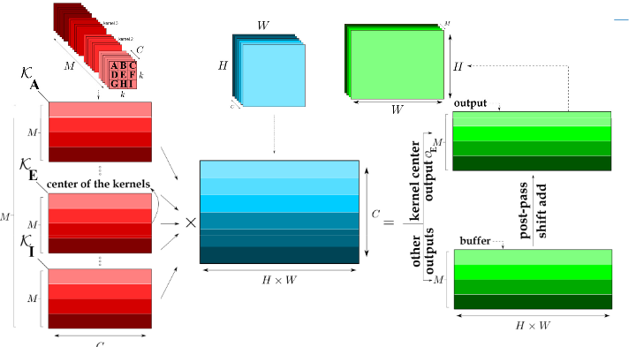
Kernel Accumulating Algorithms

Slide 9
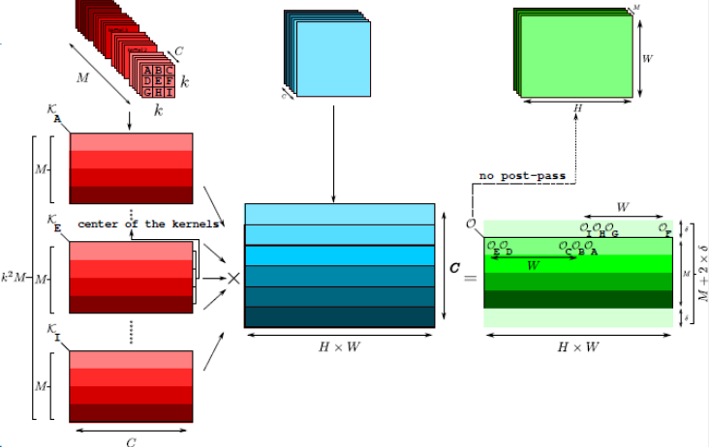
GEMM Accumulating Algorithms:

Slide 10
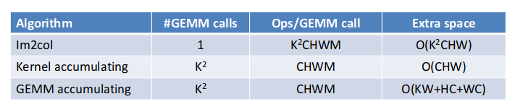
Comparison

Slide 11
References
[1] CS231n Convolutional Neural Networks. http://cs231n.github.io/convolutional-networks/, 2018
[2] Convolution in Caffe: a memo. https://github.com/Yangqing/caffe/wiki/Convolution-in-Caffe:-a-memo, 2018
[3] Caffe Installation. http://caffe.berkeleyvision.org/installation.html, 2018
[4] Netlib BLAS. http://www.netlib.org/blas/, 2018
[5] Nvidia cuBLAS. https://developer.nvidia.com/cublas, 2018
[6] https://ieeexplore.ieee.org/document/7995254
[7] https://www.groundai.com/project/the-indirect-convolution-algorithm/1
[8] https://arxiv.org/pdf/1706.06873.pdf

Slide 12
Thank you

